Slide 1

Academic Skills for Successful Postgraduate Study
Student Learning Development
http://student-learning.tcd.ie
student.learning@tcd.ie
Caitríona Ní Shé

Slide 2

Which academic skills?
Please answer this anonymous poll
You can use the QR code
Or
You can go to vevox.app and type in the code 188-031-989

Slide 3
Aim of this session
Explore the following academic skills in the context of postgraduate study in Trinity College Dublin
Planning & time-management
Effective study methods
Academic writing
Other Skills (if time permits)

Slide 4

Self-regulated learning
Actively plan, monitor, and evaluate your own cognitive, emotional, and behavioral learning processes.
You control
motivation
methods of learning
use of time
physical and social environment
monitoring performance
(Denbo & Seli, 2013)

Slide 5
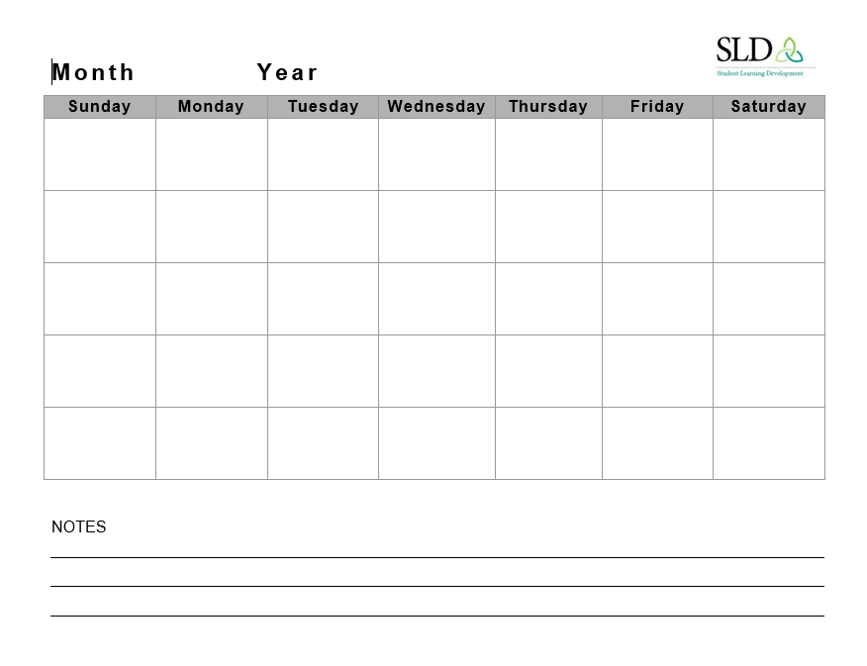
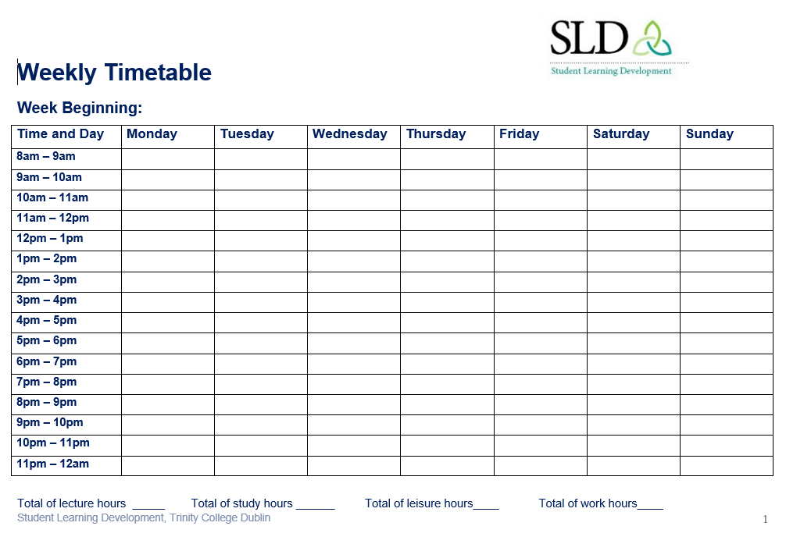
Scheduling
Plan your workload
Commitments – non negotiable
Don’t forget down time

Slide 6
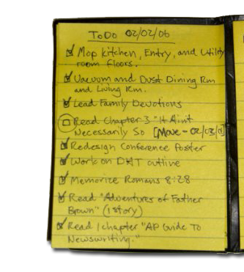
To-do list
Make a list of all tasks
3 Ds:
    Do it- takes 2 mins? Do it now!
    Schedule it ->2mins add it to your list
    Dump it! If not important

Slide 7

Setting Goals
SMART GOALS
S = Specific
M= Measurable
A = Achievable
R = Relevant
T = Time-based

Slide 8
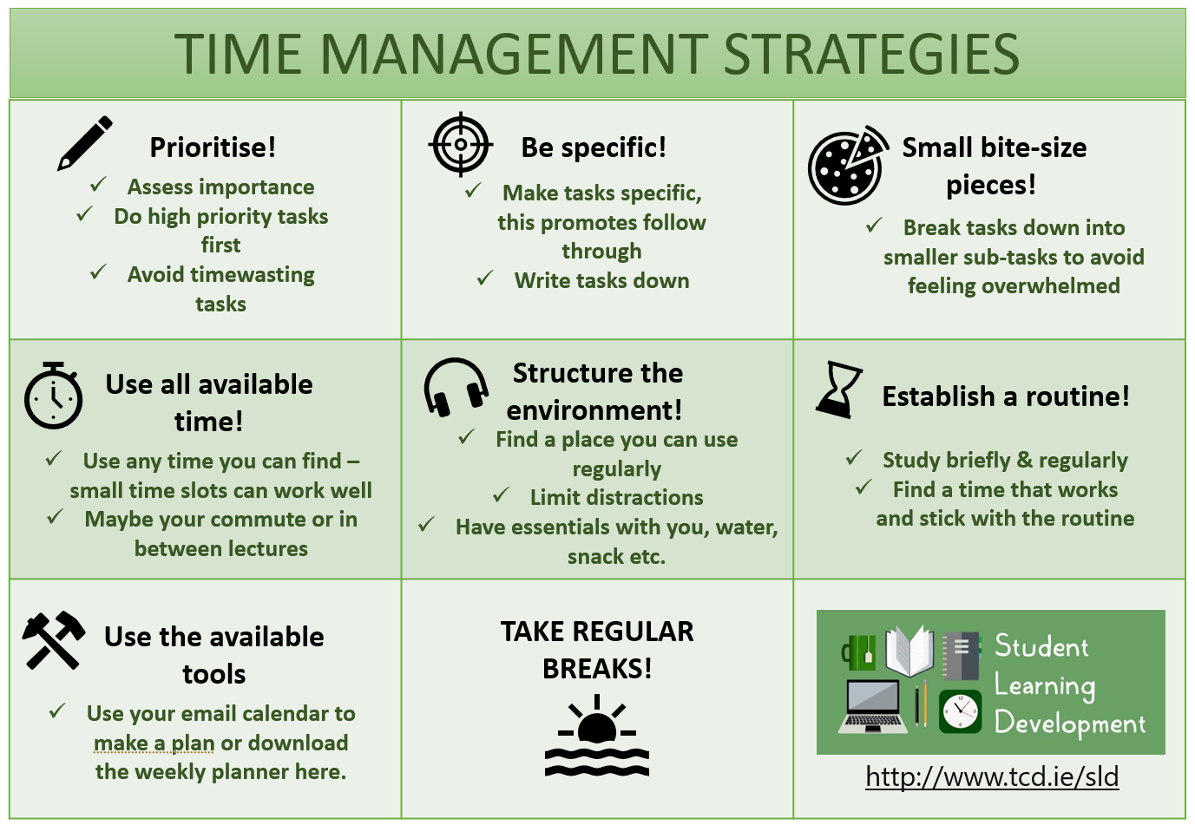

Time Management Strategies

Slide 9
Setting Priorities
 | High Urgency | Low Urgency
High Importance | 1 Do it now – due tomorrow | 2 Plan to do it – due in x weeks
Low Importance | 3 Resist giving it priority-other people | 4 Time Wasters 20 pdfs open
https://www.eisenhower.me/eisenhower-matrix/ Video

Slide 10

Pomodoro technique
Time blocking system
  25 minutes = a pomodoro, 5 minute break
  4 pomodoros, long break
Online, app, other e.g.
  https://pomofocus.io/

Slide 11
Learning Preference ?
Please answer this anonymous poll
You can use the QR code
Or
You can go to vevox.app and type in the code 188-031-989

Slide 12
Learning Preferences​
Everyone learns and processes information differently​
Visual
Auditory
Read/write
Kinaesthetic
No ‘right’ way to study or learn!​

Slide 13
Effective learning methods
Practice testing / questions
Distributed practice
Elaboration
Making associations
Activate prior knowledge
Recognise patterns/organize info
Concrete examples

Slide 14
Bloom’s Taxonomy
Creating
Putting elements together to form a coherent or functional whole; reorganizing elements into a new pattern or structure through generating,
planning, or producing.
Making judgments based on criteria and standards through checking and critiquing.
Evaluating
Breaking material into constituent parts, determining how the parts relate to one another and to an overall structure .
Analyzing
Carrying out or using a procedure through executing, or implementing.
Applying
Constructing meaning from oral, written, and graphic messages through interpreting, exemplifying, classifying, summarizing, inferring, comparing, and explaining.
Understanding
Retrieving, recognizing, and recalling relevant knowledge from
long-term memory.
Remembering

Slide 15

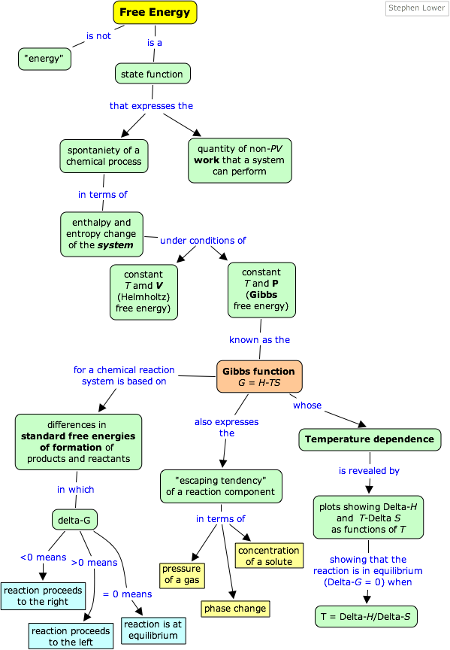
Examples of Active, Deep Processing Strategies
Discussion
Visualisation
Teaching someone/thing else
Asking Questions
Diagrams
Concept maps
Recording yourself
This Photo by Unknown Author is licensed under CC BY-SA

Slide 16
Concept Maps
Disease
Clinical
Manifestations
Etiology
Nursing
Interventions
Signs/
Symptoms
Diagnostic
tests
Nursing actions
Meds
Diet
Physio
Psych

Slide 17

Start early
Not necessarily first thing in the morning!
But
In September

Slide 18

Organise your space
Where do you work best?
Place suitable to task
Set it up for your studies
If you don’t have a dedicated space – get a large plastic box and make a mobile study station!
Notes:
Lists

Slide 19
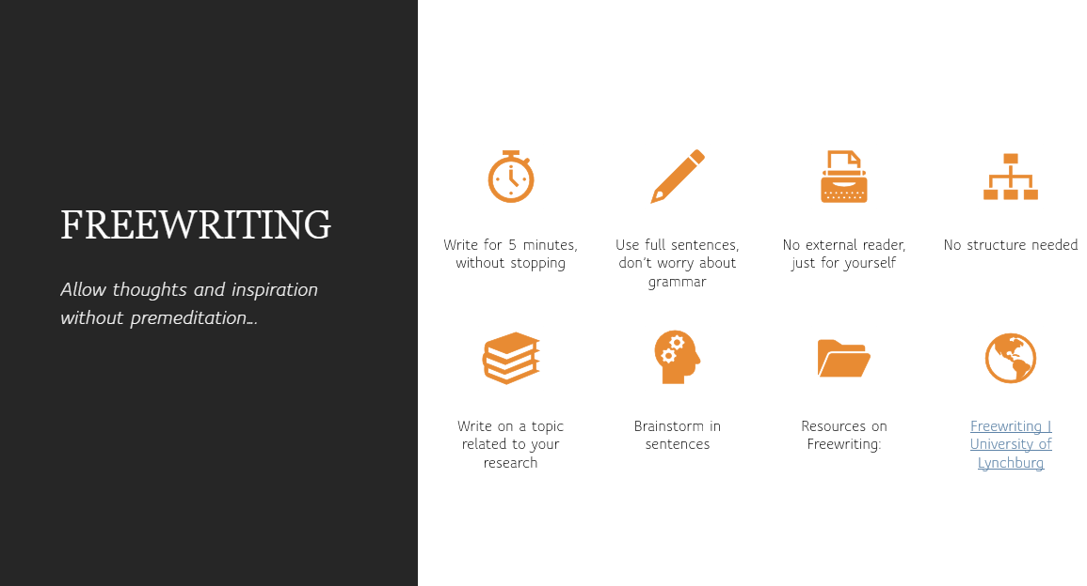
Getting Started
Five minutes of free writing

Slide 20

Free writing Exercise
Take five minutes:
Write full sentences on what you know, or don’t know, about academic writing at Masters level in Trinity.

Slide 21
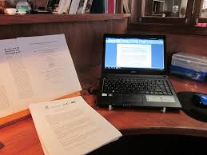
Features of academic writing
Formal language
Clarity & cohesion
Detached & objective
Argument with evidence (referencing)
Critical & analytical

Slide 22
1. Formal language
Avoid the three Cs:
  Contractions (isn't, didn't could've etc);
  Clichés (in the nick of time, this day and age etc)
  Colloquialisms (kids, mums, loads of, cool etc).
More formal words:
  use 'quotation' rather than 'quote’,
  'many' rather than 'lots of' and
  'obtain', 'acquire' or 'become' instead of 'get’
Pronouns – Avoid first person (I) or third person (It)

Slide 23

2. Clarity
Concise
Coherent
Cohesive
Logical structure
  Overall
  Paragraph level

Slide 24
3. Detached & objective
Example:
  Wrong: The conditions were really horrendous. It is no wonder that so many of the poor children suffered such dreadful diseases.
  Right: The conditions were poor and were likely to have contributed to the high levels of childhood infectious diseases that were observed.
  From “Writing Academically: Academic Style,” University of Hull
Cautious, hedging language – but don’t overdo it!

Slide 25
4. Argument with evidence
A strong argument is convincing; it offers evidence to back up the position. ​
Draw on and cite a range of authors & arguments​
Balanced viewpoint​
In business disciplines evidence for your argument might include peer-reviewed journals, empirical data from surveys, interviews or case studies, industry and professional reports (McKinsey, OECD) and official government or orginisational statistics

Slide 26
Range of Evidence
Drawing on and citing a range of authors & arguments, how to link and compare
Use signposts, links and transitions
See Academic Phrasebank for useful phrases

Slide 27
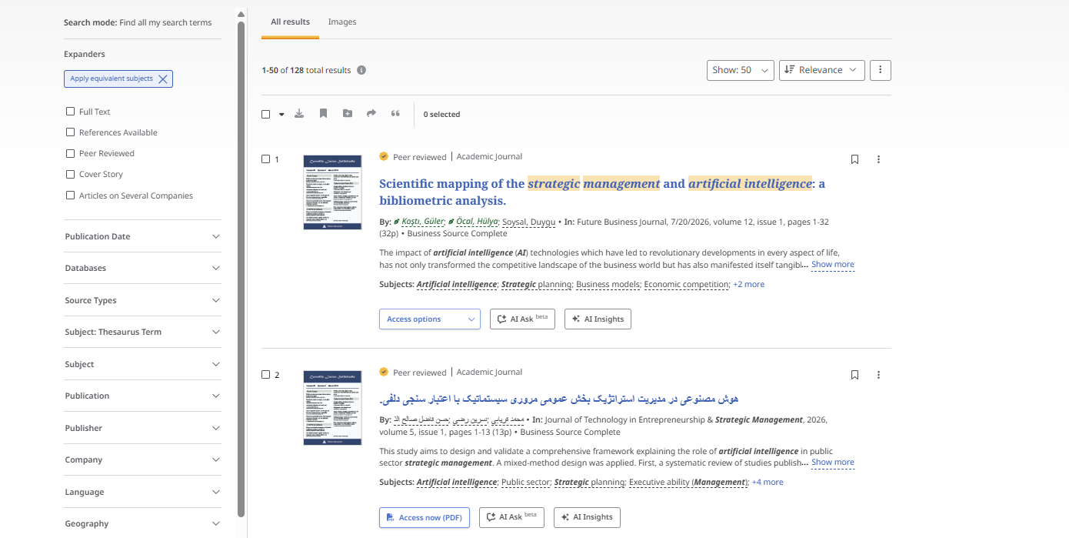
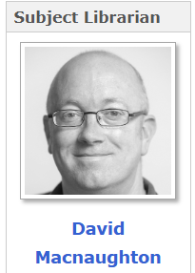
Obtaining evidence - researching your topic
Know where to look
  databases (see databases recommended for business
Subject Librarian
Remember to keep track of sources!

Slide 28
Referencing
Please answer this anonymous poll
You can use the QR code
Or
You can go to vevox.app and type in the code 188-031-989

Slide 29
Referring to ideas, thinking & writing of others
We report another author’s ideas by using paraphrase, summary, quotation and synthesis
We use introductory phrases and reporting verbs to communicate our relationship to the ideas that we are reporting.
  Brown (1983, p.231) claims that a far more effective approach is ...
  Brown (1983, p.231) points out that a far more effective approach is ...
  A far more effective approach is ... (Brown 1983, p.231)
  Regional Writing Centre, University of Limerick. https://ulsites.ul.ie/rwc/

Slide 30
Referencing
Why reference?
Refencing supports the achievement of academic integrity in that it enables you to:
credit your sources of information or ideas, and thus avoid plagiarism
provides evidence to back up your arguments
demonstrates your breadth of knowledge
allows the reader locate the sources for further reading
From the library Academic Integrity: Referencing Practices

Slide 31

5. Critical & Analytical
‘the act or practice of thinking critically (as by applying reason and questioning assumptions) in order to solve problems, evaluate information, discern biases, etc.’ ​
(https://www.merriam-webster.com/dictionary/critical%20thinking)
An objective, informed judgement​

Slide 32
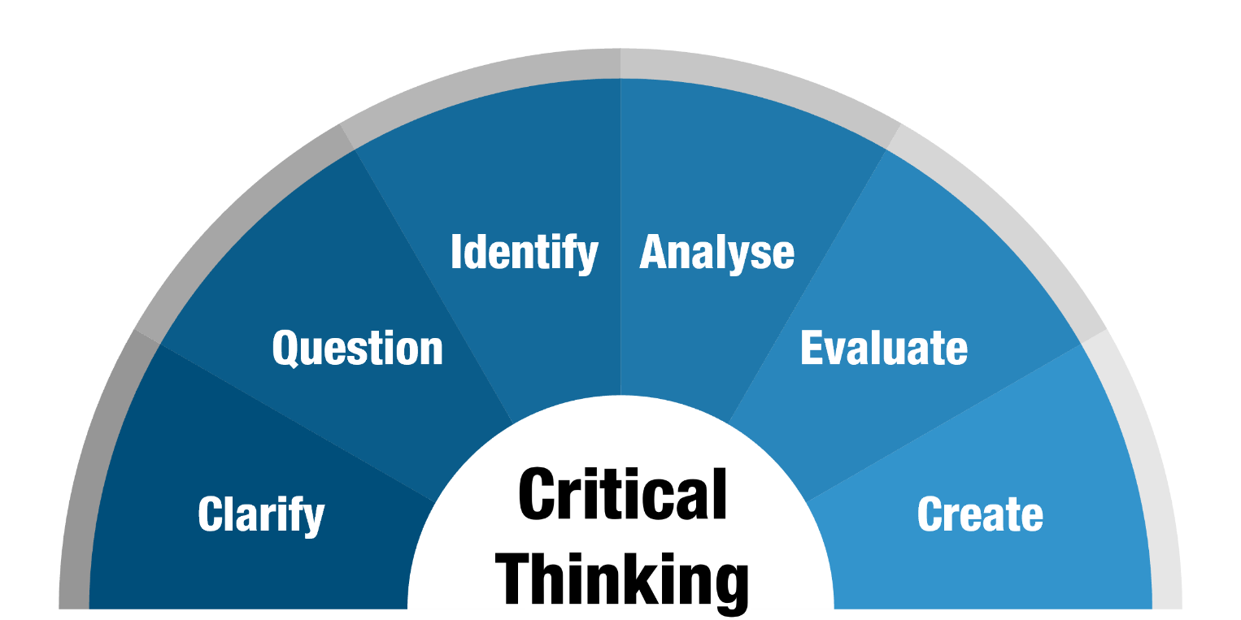
Strategies for Thinking Critically
From Monash University, “Critical Thinking” https://www.monash.edu/rlo/research-writing-assignments/critical-thinking
Notes:
A very useful source from Monash University:
In the academic context, critical thinking is most commonly associated with arguments. You might be asked to think critically about other people's arguments or create your own. To become a better critical thinker, you therefore need to learn how to:
clarify your thinking purpose and context
We live in a world oversaturated with information of varying quality and relevance. To be an effective critical thinker, you need to focus on your own purpose and context, so that you can avoid information overload and keep track of your own line of thinking.
question your sources of information
Not all sources of information are equally credible, accurate or relevant. Questioning your sources will sharpen your thinking, help you select the most appropriate information and prepare the ground for further analysis and evaluation
identify arguments
Arguments can be found everywhere. Whenever somebody is trying to show that something is true, or persuade somebody else to agree with them, you can identify an argument. As a student, you will find that the ability to identify arguments is one of the most useful critical thinking skills
analyse sources and arguments
To analyse something means to examine it in detail, explain and interpret it. For the purposes of critical thinking you need to be able to examine sources, arguments, theories and processes, and explain how they work. Good analysis also involves examining, interpreting and explaining the interaction of evidence, reasoning, assumptions, methodologies, claims and arguments
evaluate the arguments of others and
Evaluation should consider and explain the relative strengths and weaknesses of your sources and the arguments they present. You need to be able to evaluate arguments, the claims that support those arguments, the evidence that supports those claims and the reasoning that connects them all.
create or synthesise your own arguments.
Creating arguments consists of bringing together evidence, reasoning and claims and developing your own main claim. Creating arguments is also called synthesis, which means “placing things together.” When you create arguments, you bring together the insights from your analysis and evaluation. You also consider how your critical thinking might apply in the broader context, and what new insights and perspectives it brings.

Slide 33
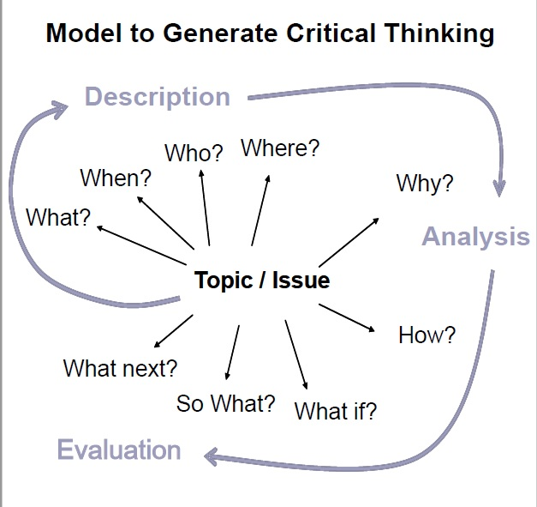
Strategies for Thinking Critically
From Plymouth University, “Model to Generate Critical Thinking”
Step-by-step guide | Diagram handout
Notes:
This model is something that we like to use to help you generate questions.
Start easy, move to more abstract
What is my topic about?
When did it happen?
Who am I writing about?
Why did this happen?
How does it happen?
What if the situation had been different?
Last two: so what? What next? – this is about connecting your research to the world. What does this mean – for my topic, for the field, etc.
You will find this model on our Bb module

Slide 34
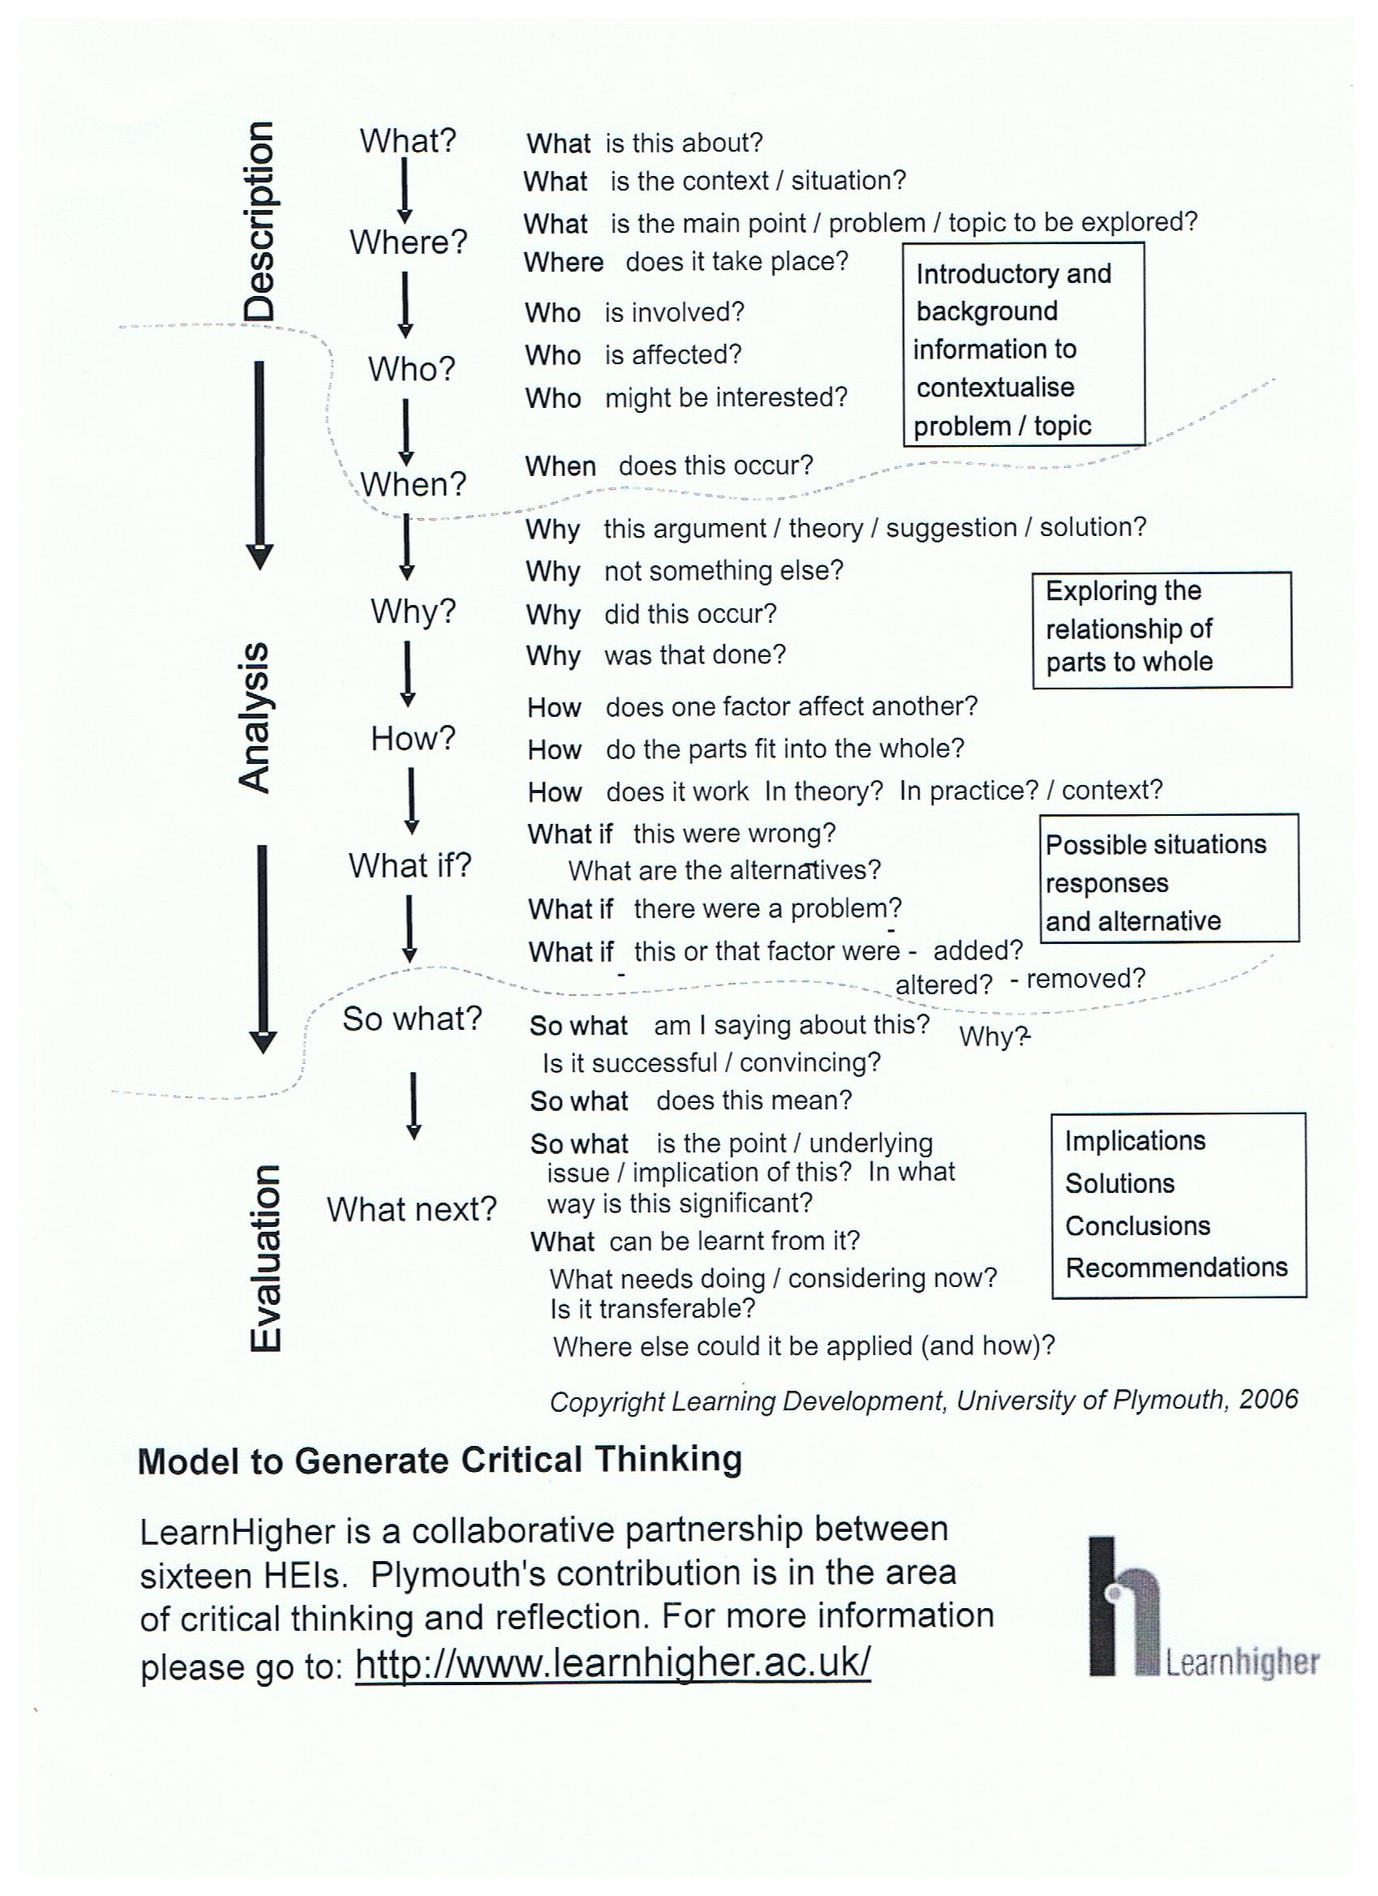
Plymouth Model descriptions

Slide 35
Descriptive
Sample: Smith (1970) reported that bilbies come out at night and eat chocolates. Jones (1972) described the variety of beetles eaten by bilbies on their daytime trips. Wheeler (1974) reported that bilbies eat only apples.
How to improve this?
Ask questions of the text:
What is the conclusion about bilbies that can be drawn from these facts?
What is the common denominator?
Notes:
This paragraph from a literature review of a thesis is an early draft and needs development
To rewrite, find the important point in the information and place it in a theme sentence in the beginning of the paragraph.
What thoughts / new research / speculations do the data suggest?
To rewrite, think of the implications of the literature and develop these ideas at the end of the paragraph.
This work is key in bringing your voice to the fore – don’t just show, do a show and tell

Slide 36
More analytical
The elusive bilby has provoked considerable disagreement over such essential facts as whether it is diurnal or nocturnal, and what constitutes its staple diet. Smith (1970) considered them to be nocturnal whereas Jones (1972) reported that they are daytime foragers. Smith (1970) also reported bilbies had a fondness for chocolate but his findings were rejected by both Jones (1972) and Wheeler (1974). Jones believed bilbies eat beetles, and Wheeler thought that apples were the staple food. However, neither chocolate nor apples are indigenous to the bilby habitat and it seems improbable that they are the main foodstuffs for bilbies.
Eucalyptus leaves, on the other hand, are widely available in the bilby region …..
(From Dunn, 2007, p. 8)

Slide 37
Tips
No matter how you phrase something or your individual writing style you must show the reasoning of your argument—this is key to critical thinking in writing!
Always highlight the ‘So what?’ of any claim you make.

Slide 38
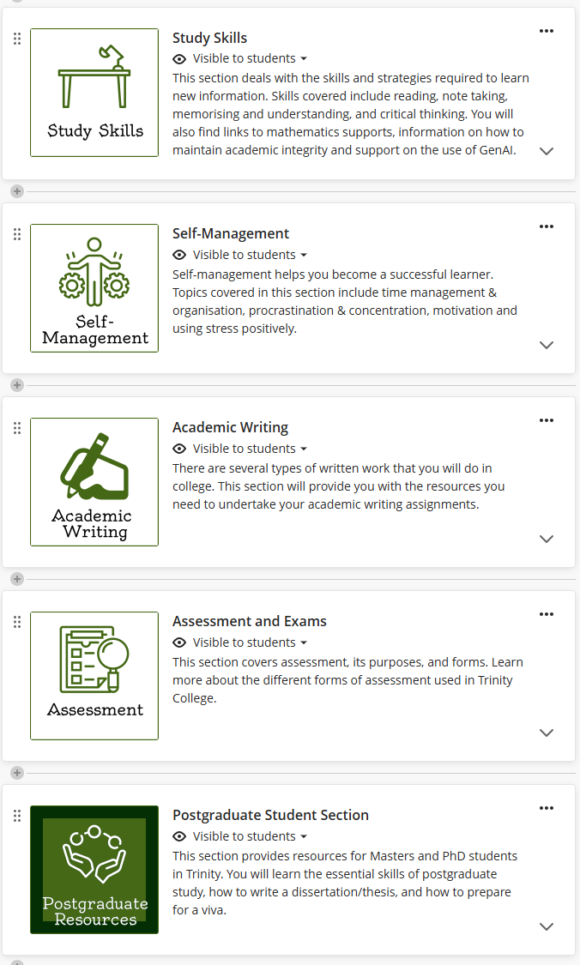

Find us on Blackboard
Further Resources
Log into Blackboard.
Click Modules in the left menu.
Click Module Catalogue in the top right corner.
Search for ‘Academic’.
Find the ‘ASSL-SLD’ module. Click on and ‘Enrol’.

Slide 39

Choose from our individual services
Individual Services - Student Learning Development | Trinity College Dublin
No slots available? Email us at
student.learning@tcd.ie
and ask for an in-person appointment

Slide 40
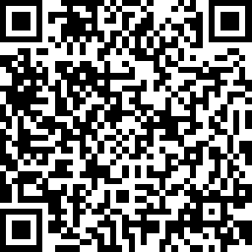
Thank you. Feedback, please!
https://eu.surveymonkey.com/r/SLDWorkshop

Slide 41
Doing well is…
Knowledge/Skills
Attitude/Mindset
Exam Performance

Slide 42
Exam Timetable
Monday | Tuesday | Wednesday | Thursday | Friday | Saturday | Sunday
20th April | MCQ (40% of module xyz) 10 - 12 |  | Written Exam (80% of module abc) 10 – 13
27th April | Exam (100% of Module mno) 9 - 12 | Written Exam (70% of module def) 10 – 13 |  | MCQ (60% of module rst) 10 -11:30

Slide 43
What you need to know
What % of overall module assessment is this worth?
What type of exam (MCQ, short answer, essay)?
How much time you will have to complete exam/Qs?
How many questions will there be?
How much is each question worth?
What topic areas to be covered?
How long answers should be (strict word limit)?
Notes:
MCQ – fast, accurate, factual – distinguish between list of similar answers – no time to look up answers – answer the ones you know first then go back to the others, work as fast as you can, be very aware of your timing
Short questions – very short, to the point answers, often one or two sentences or a list of points. E.g. what there the 7 steps in the x process. Think of how much time there is for each question. Look at the weighting and give time accordingly
Essay questions – much longer timeframe, need to be able to explain/argue/justify a position and provide evidence to support it. Needs to be structured in a logical way. Practise developing outlines for questions and what the key points are for each one.

Slide 44
Revising- what and how
List major topics using your notes/past papers
Create a chart/summary sheet of main topics and how they are connected
Organise your notes
Look at past exam papers
What works for you?

Slide 45
MCQ Study preparation
Think vocabulary, words, terms, concepts, systems, short calculations
Create flash cards and test yourself – recite for precision
Create summary sheets, diagrams, charts, tables, mind maps
Note formula etc for short calculations
Notes:
Just one approach

Slide 46
Answering MCQs
Timing/how long per question/time to review at end
Read each question carefully
Circle key words or negatives
Identify modifiers and qualifiers (e.g. only, never, sometimes)
Anticipate answer before looking at options
Read all options before making a choice
Check before marking answer

Slide 47
Short Questions Study Preparation
Knowledge
Understanding key ideas/facts at basic level
Think definitions and their meaning
Practice answering
Notes:
Exams can be 100% of the module mark or a portion e.g. if CA is part of the module assessment also

Slide 48
Answering Short Questions
Timing/how long per question/time to review at end
Read carefully, what are they looking for?
What do I know about this?
How would I answer this? (Define key words, concept)
Stay relevant
Notes:
The idea is to plan your week based on how you might feel.
Energy Timetable

Slide 49
Essay (or long form questions)
Study Preparation
Knowledge and its application
Putting key ideas/facts into operation and critical thinking
Think about the structure of your answers
Practice answering
Notes:
Exams can be 100% of the module mark or a portion e.g. if CA is part of the module assessment also

Slide 50
Answering Essay Style Questions
Timing/how long per question/time to review at end
Read carefully, can you answer all parts?
What do I know about this? Can you solve the question?
How would I answer this? (Structure, apply concepts)
Stay relevant
Notes:
The idea is to plan your week based on how you might feel.
Energy Timetable

Slide 51

Time Management is Important
Notes:
You need to know how much time you have to revise and then decide how you’re going to use that time
If you don’t make a plan, you won’t know what you have time to revise, what you have done, what is left to do

Slide 52
Exam Skills
Please answer this anonymous poll
You can use the QR code
Or
You can go to vevox.app and type in the code 188-031-989

Slide 53
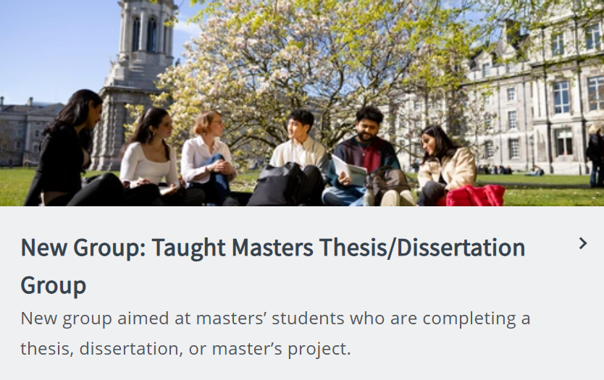
PG Groups - Thesis
Commencing in January 2026

Slide 54
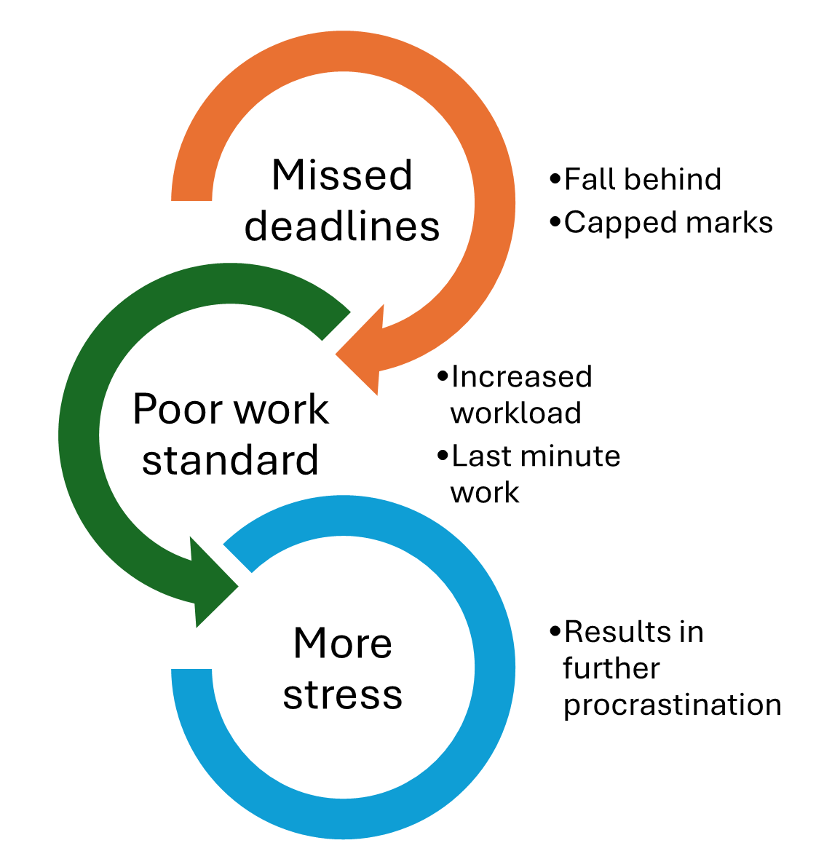
Overcoming Procrastination
Take Action
Courgette Technique
Five Minutes
Related Tasks
Worst first
Visualise the finished product
Notes:
Procrastination is when we delay or put off something we know is to our benefit.
Most people practice procrastination! What is important is to know when it is time to stop making excuses and to do something. Here are some strategies that might help you out. Once again it is important to find ones that work for you – so monitor and evaluate.
Take Action – sometimes just doing something creates the mood and momentum to continue, so decide to just do something, anything to get you going.
Salami Technique – slice a task or goal down by function and time, getting down to smallest unit. This is useful if your excuse for putting it off is that it’s so big or you have so much to do can’t start. For example, a long reading assignment in a difficult subject can seem intimidating and easy to put off, divide it into several 2 page sections.
Five minutes - spending just 5 minutes, anyone can do that short a time and then see where it leads.
Related tasks – do something related; the back door approach. For example, if you have to start a project maybe decide to just go talk to someone about it, this in turn may lead you to the library because they suggest a reference. Often it can be easier to talk to someone then having to sit down and write.
Worst first – that particularly boring or difficult task is easy to put off, in fact you’ll do anything not to get it done but better to get it out of the way. Mark Twain said something to the effect, “It’s best to eat a live frog first thing in the morning…”
Make commitments – An oft used excuse is “I work better under pressure”, so create pressure. Tell people you plan to get something done, then they’ll ask if you got it done.
Not all procrastination is bad – but it is important to be realistic and honest. “Is this really working in my best interest? Maybe I work better under pressure but do I do the best job? Is it worth the stress?” Ask the questions!! Monitor and evaluate.
(Remind students that strategies don’t work all the time or for some people. Must learn to self-regulate and match strategies).

Slide 55
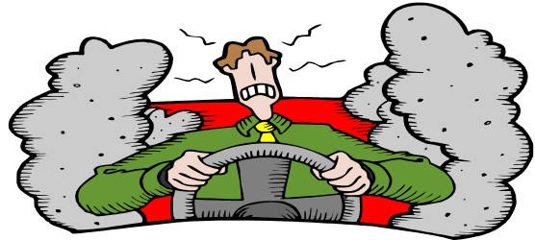
What is Stress?
Stress results when we perceive an imbalance between the demands placed on us in a given situation, and our resources for meeting those demands.
This involves 3 components:
The situation and its demands.
Our subjective appraisal of the situation.
Our perceived resources for meeting the demands
Student Counselling services: https://www.tcd.ie/studentcounselling/

Slide 56

Cognitive Strategies
Reframe
Challenge negative thinking
Positive self-talk
Keep perspective
Visualisation
Reduce uncertainty

Slide 57

Behavioural Strategies
Physical exercise
Breathing & relaxation
Laugh & Smile
Healthy Diet & Sleep
Seek help
Worry time

